Slide 1
Machine Learning-Assisted Prediction of
Electro- chemcial Corrosion Behavior in High-Entropy Alloys

Slide 2
Why Corrosion Matters :
🛠 Industrial Impact
Corrosion is a major challenge in metallurgy, construction, and manufacturing industries.
In India alone, corrosion-related damages account for ~7% of GDP annually.
🌊 Environmental Exposure
Materials often operate in corrosive environments (acids, alkalis, seawater).
Leads to rapid degradation, loss of functionality, and severe safety hazards.
🚨 Need for Advanced Materials
Current materials degrade quickly in harsh environments.
There's a pressing demand for next-generation corrosion-resistant alloys.

Slide 3
Background on High-Entropy Alloys (HEAs)
What Are HEAs?
Proposed by Yeh in 2004, HEAs consist of 5+ principal elements in equimolar ratios.
Defy traditional alloying concepts focused on one or two main elements.
🧩 Unique Material Effects
High-entropy effect: Enhances phase stability.
Lattice distortion: Increases resistance to deformation.
Sluggish diffusion: Slows down atomic movement, improving stability.
Cocktail effect: Synergistic interactions lead to superior performance .
⚔️ Why HEAs Matter
Outperform stainless steel, titanium, and aluminum alloys in toughness and wear resistance .
High potential for structural applications in corrosive environments.
⚠️ Design Challenge
Massive compositional space makes empirical optimization infeasible.
Corrosion resistance often overlooked in favor of mechanical properties

Slide 4
Leveraging ML in HEA Corrosion Prediction
Role of Machine Learning (ML)
ML accelerates alloy discovery by identifying hidden trends in experimental data.
Transition from trial-and-error to predictive, performance-oriented design .
📊 Corrosion Property Prediction
Focused on key indicators:
Corrosion potential (Ecorr) – measures material’s thermodynamic stability.
Corrosion current density (Icorr) – quantifies corrosion rate.
🧠 Our ML Framework
Dataset created from peer-reviewed electrochemical data.
Feature engineering: created 100+ descriptors based on elemental properties.
Applied a “three-step” feature selection method.
Evaluated multiple ML regression models for best prediction accuracy.
Interpreted results using SHAP (Shapley Additive Explanations) to reveal key features.
🚀 Impact
Enables rapid screening of HEA compositions with optimal corrosion resistance.
Bridges the gap between data science and material innovation.

Slide 5
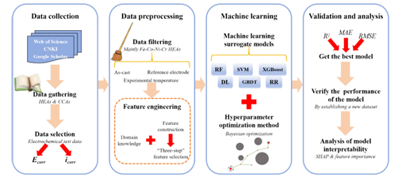
Data Collection Techniques
Reviewed literature from academia databases like Web of Science and Google Scholar. Extracted critical information from academic studies including: Alloy composition & state
Preparation method,Testing temperature,Solution environment,Reference electrode
Electrochemical parameters:Corrosion potential, Corrosion current density Filtered data to focus on as-cast HEAs conducted under standardized testing conditions.

Slide 6
Data Pre processing
Data Filtering Strategy
Selected only room temperature electrochemical tests.
Focused on as-cast HEAs prepared via vacuum arc melting.
Standardized corrosion potential (Ecorr) values to SCE reference using:
ESCE = ESHE− 0.241 V
ESCE= EAg/AgCl+ 0.044 V
📦 Post-filtering Dataset
315 data points retained
304 for icorr
315 for Ecorr
Applied −log₁₀(icorr) transformation to reduce scale variance

Slide 7
Feature Engineering
Feature Engineering :
Environmental Parameters:
Environment type (encoded: NaCl, H₂SO₄, NaOH, HNO₃, HCl → 0–4) pH, [Cl⁻], [SO₄²⁻]
Material Phase-Related Empirical Features: Δsmix, Δhmix, δ, Ω, VEC, r̄, χ̄, etc.
Phase structure information improves prediction fidelity
Total Features:
21 elemental compositions, 13 empirical phase parameters, 4 environmental descriptors
➤ 38 features in total
✂️ Dimensionality Reduction
To avoid overfitting and redundancy:
Applied a three-step feature selection process:
Pearson Correlation Coefficient
Feature Importance (e.g., via tree-based models)
Recursive Feature Elimination (RFE)

Slide 8
ML Models
Preprocessing
Standardized all features to ensure effective model convergence
🧠 ML Models Used
Five regression models applied: Random Forest (RF), Support Vector Machine (SVM), Gradient Boosted Decision Trees (GBDT), XG Boost, Ridge Regression (RR)
🎯 Hyperparameter Tuning
Explored methods:
Grid Search, Random Search, ✅ Bayesian Optimization (BO)
BO Advantage: Efficient tuning with prior knowledge incorporation and adaptive learning
🔀 Training Strategy
Dataset split: 80% Training / 20% Testing
5 Random Splits:
Models trained on each split and best-performing configuration retained

Slide 9
Validation and Analysis
Performance Metrics
Used to assess prediction accuracy:
R² (Coefficient of Determination) → Closer to 1 is better, MSE (Mean Squared Error), RMSE (Root Mean Squared Error), MAE (Mean Absolute Error)
🔍 Lower values of MSE, RMSE, and MAE indicate higher accuracy
🧪 Experimental Validation
Constructed a new dataset (from previous electrochemical tests)
Purpose: Validate generalization ability of the best-performing model
Dataset is independent of the original training/testing sets
🧠 Model Interpretability
Feature Importance Analysis
✅ SHAP Analysis (SHapley Additive exPlanations)
Based on game theory, Evaluates individual feature contributions per prediction
Offers deeper insights than simple feature importance rankings
Ideal for complex models

Slide 10
Results and Analysis : Three Step Feature Validation
1. Pearson Correlation Analysis
Used to identify redundant features (|correlation| > 0.8)
Redundant pairs identified in predicting icorr :
(VEC, r), (VEC, χ), (Tm, Ecorr), (e/a, σT)
➤ Removed: r, χ, σT,Ec
From elemental composition: Redundancies in (Hf, Ta) and (C, P)
➤ Removed: Hf, Ta, P
Similar approach applied to Ecorr with respective removals
🌳 Step 2: Random Forest Feature Importance
RF used to rank features by contribution to predictive performance
Low-importance features removed for icorr : [SO₄²⁻], Si, V, B, Mo, Sn, Y, C, Zr, W
For Ecorr : Si, V, C, Sn, W, Zr, B were excluded
🔁 Follow-up: Pearson correlation on remaining features
Removed: Al (highly correlated with e/a, low contribution)
For Ecorr : Removed Al, Ti

Slide 11
Validation and Analysis
🔁 Step 3: Recursive Feature Elimination (RFE)
RFE with RF used to minimize MSE by testing different feature subsets
Optimal feature count = 11 for predicting icorr
➤ Domain knowledge adjustment: Retained [Cl⁻] due to its known importance in corrosion
✅ Final Feature Sets
For Icorr:
Environment, PH, [Cl⁻], ΔHmixδ, Δχ, e/a, Tm,Cr, Fe, Ni, Cu
For Ecorr
Environment, PH, [Cl⁻], σVEC, Δhmix, χ, e/a, Tm, Co, Cr, Y
📌 Key Insight
Icorr reflects corrosion kinetics, while Ecorrindicates thermodynamic trends
➤ Distinct feature sets are required for accurate prediction of each

Slide 12
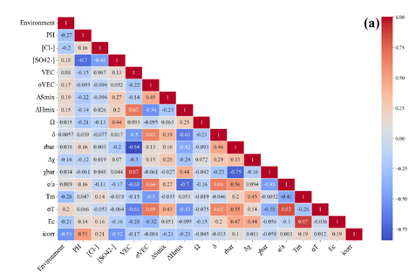
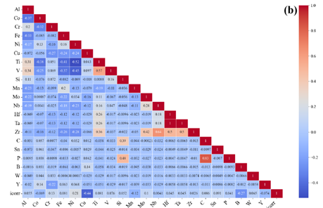
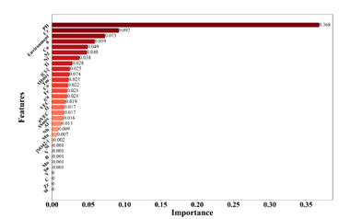
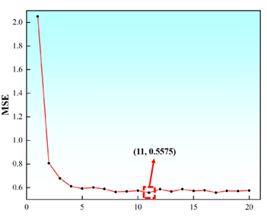

Slide 13
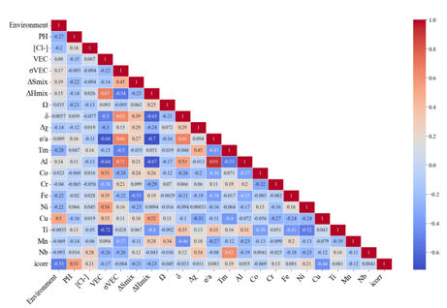

Slide 14
Evaluation and comparision of Models
Model Performance for Predicting icorr, Ecorr : Best Performing Models (Test Set)
Icorr XGBoost (81.02%) > GBDT (80.93%) > RF (78.14%) > SVM (76.51%) > DL (66.2%) > RR (51.51%)
Ecorr GBDT (84.64%) > XGBoost (81.46%) > SVM (80.43%) > RF (79.63%) > DL (67.57%) > RR (53.75%)
Key Insights
XGBoost & GBDT showed the best fitting performance, with the lowest MAE and RMSE for both icorr and Ecorr.
Both models excelled in generalization with higher accuracy and better performance on the test set.
Model Comparison Scatter Plots:
Data points closer to the diagonal line indicate higher prediction accuracy and better generalization.
Boosting Algorithms:
XGBoost and GBDT (decision tree-based) showed strong performance but are prone to overfitting due to their sensitivity to noise.
Hyperparameter Tuning
BO Adjustment improved the performance of all models.
Best Hyperparameters for each model

Slide 15
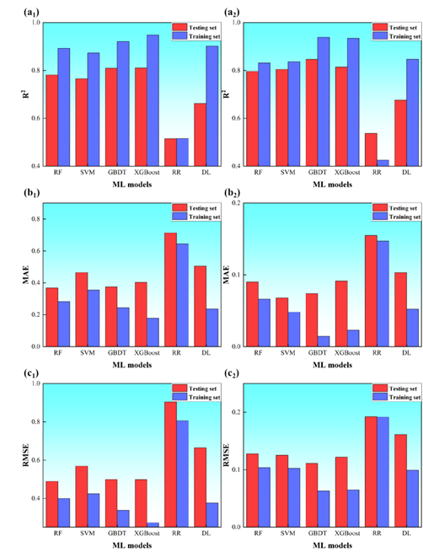
Validation and Analysis

Slide 16
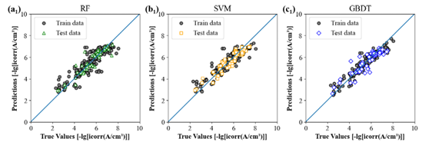
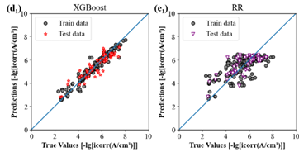
Performance Icorr :

Slide 17
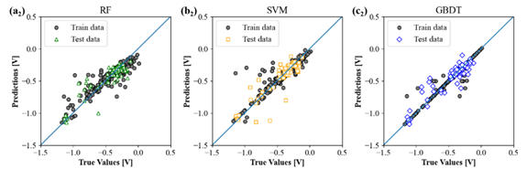
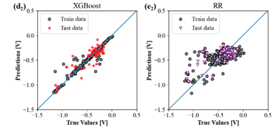
Performance Ecorr :

Slide 18
Model Validation :
Validation on New Experimental Dataset
A new dataset of 3 HEAs was created from our group’s previous electrochemical corrosion experiments. Prepared using vacuum arc melting
Tested in 3.5 wt% NaCl at room temperature using RST5200F three-electrode system
Tafel polarization curves measured at 1 mV/s, repeated 3 times for reproducibility
Polarization curves shown
✅ Model Performance on New Dataset
All models were tested on this unseen dataset to assess their generalization capability
Unlike the original test set (which included known HEA systems), this dataset introduced new HEA compositions
Results:
Models showed good prediction ability
Some deviations occurred due to: Small dataset size, Data quality limitations, Algorithmic constraints Overall errors remain within acceptable bounds

Slide 19
Analysis of Model Interpredictability :
ML models (e.g., XGBoost, DL) are powerful but complex — feature importance and SHAP values help reveal how input features affect corrosion prediction (𝑖₍cₒᵣᵣ₎, E₍cₒᵣᵣ₎).
📊 Top Influential Features
pH: Most influential; lower pH → more acidic → faster corrosion
[Cl⁻]: Halide ions accelerate corrosion
Δχ, δ: Reflect electronegativity & lattice distortion → affect diffusion & galvanic behavior
Cr: Contributes to passivation (Cr₃⁺ layer)
Cu: Higher oxidation tendency → lowers corrosion resistance
σVEC: Positively correlates with E₍cₒᵣᵣ₎; stabilizes electronic structure
🧪 Validation on Experimental Dataset (Table 3)
CrMnFeCoNi, CrMnFeCoNiSi₀.₃, CrMnFeCoNiSi₅.₇ tested
Predicted values for 𝑖₍cₒᵣᵣ₎ & E₍cₒᵣᵣ₎ closely matched experimental values
Relative errors ≤ 12.4%, indicating strong generalization
🚀 Model Performance
Model Best For R² Score (%) XGBoost i₍cₒᵣᵣ₎ 81.02, GBDT E₍cₒᵣᵣ₎ 84.64
✅ Excels on small datasets, robust accuracy
🔄 SHAP analysis confirms logical, domain-aligned feature contributions

Slide 20
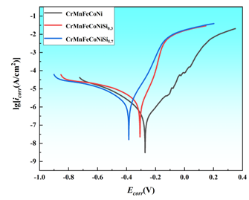
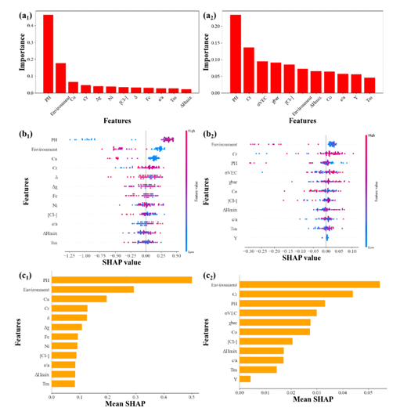

Slide 21
Conclusion :
This work pioneers a data-driven design strategy for High-Entropy Alloys (HEAs), using machine learning to predict corrosion indicators (I₍cₒᵣᵣ₎ & E₍cₒᵣᵣ₎), supporting performance-first alloy development.
🔍 Key Conclusions
1️⃣ “Three-Step” Feature Selection, Pearson correlation + Feature Importance + RFE
➡️ Reduced features from 38 → 12 (𝑖₍cₒᵣᵣ₎), 11 (E₍cₒᵣᵣ₎)
🔋 Improved efficiency & model clarity
2️⃣ Generalization & Model Strength
📊 Good performance on validation dataset
⚠️ Further improvement possible with larger, cleaner datasets
3️⃣ Interpretability Insights
🧠 SHAP + Feature Importance show top drivers of corrosion behavior:
pH (dominant environmental factor), Δχ, χ̅ (electronegativity parameters), [Cr], [Cu] (key alloying elements)
✅ Findings align with experimental evidence
💡 Impact
Combines experimental knowledge with ML insights to accelerate corrosion-resistant HEA design — a promising tool for materials innovation.

Slide 22
References :
1. C. Nyby, X. Guo, J.E. Saal, S.C. Chien, A.Y. Gerard, H. Ke, T. Li, P. Lu, C. Oberdorfer, S. Sahu, S. Li, C.D. Taylor, W. Windl, J.R. Scully, G.S. Frankel, Electrochemical metrics for corrosion resistant alloys, Sci. Data 8 (2021) 58, https://doi.org/10.1038/s41597-021-00840-y.
2. Z. Lu, S. Si, K. He, Y. Ren, S. Li, S. Zhang, Y. Fu, Q. Jia, H.B. Jiang, H. Song, M. Hao, Prediction of Mg alloy corrosion based on machine learning models, Adv. Mater. Sci. Eng. 2022 (2022) 1–8, https://doi.org/10.1155/2022/9597155.
3. Y. Qiu, S. Thomas, M.A. Gibson, H.L. Fraser, N. Birbilis, Corrosion of high entropy alloys, npj Mater. Degrad. 1 (2017) 15, https://doi.org/10.1038/s41529-017-0009-y.
4. Y. Shi, B. Yang, P. Liaw, Corrosion-resistant high-entropy alloys: a review, Metals 7 (2017) 43, https://doi.org/10.3390/met7020043.
5. J.Y. Zhang, B. Xiao, T.H. Chou, B.X. Cao, Y.L. Zhao, B. Liu, K. Huang, S.B. Yang, J.C. Su, Y. Liu, T. Yang, High-entropy alloys: a critical review of aqueous corrosion behavior and mechanisms, High Entropy Alloys Mater. 1 (2023) 195–259, https://doi.org/10.1007/s44210-023-00021-z.
6. M. Ibrahim, S. El-Hadad, W. Khalifa, M. Shoeib, Effect of Ti addition and heat treatment on electrochemical properties of cast Fe₃₅Mn₃₁Ni₁₈Al₁₃Tiₓ HEAs, Inter Metalcast 17 (2023) 888–899, https://doi.org/10.1007/s40962-022-00821-w.
7. W. Li, D. Xie, D. Li, Y. Zhang, Y. Gao, P.K. Liaw, Mechanical behavior of high entropy alloys, Prog. Mater Sci. 118 (2021) 100777, https://doi.org/10.1016/j.pmatsci.2021.100777.

Slide 23
References :
8. W. Wang, H. Li, P. Wei, W. Zhang, J. Chen, S. Yuan, Y. Fan, R. Wei, T. Zhang, T. Wang, C. Chen, F. Li, A corrosion-resistant soft-magnetic high entropy alloy, Mater. Lett. 304 (2021) 130571, https://doi.org/10.1016/j.matlet.2021.130571.
9. X. Jiang, Y. Yan, Y. Su, Predicting the corrosion properties of cast and hot isostatic pressed CoCrMo/W alloys in seawater by machine learning, ACMM 69 (2022) 288–294, https://doi.org/10.1108/ACMM-01-2022-2594.
10. Y.Y. Chen, T. Duval, U.D. Hung, J.W. Yeh, H.C. Shih, Microstructure and electrochemical properties of high entropy alloys—a comparison with type-304 stainless steel, Corros. Sci. 47 (2005) 2257–2279, https://doi.org/10.1016/j.corsci.2004.11.008.
11. V.S. Raja, Grand challenges in metal corrosion and protection research, Front. Met. Alloy 1 (2022) 894181, https://doi.org/10.3389/ftmal.2022.894181.
12. B. Li, K. Peng, A. Hu, L. Zhou, J. Zhu, D. Li, Structure and properties of FeCoNiCrCu₀.₅Alₓ high-entropy alloy, Trans. Nonferrous Met. Soc. Chin. 23 (2013) 735–741, https://doi.org/10.1016/S1003-6326(13)62523-6.
13. H. Zhang, S. Lei, Y. Li, S. Cui, S. Hu, P. Wang, Microstructural evolution and magnetic and corrosion properties of FeCoNiAl₀.₂Yₓ high-entropy alloys, ECS J. Solid State Sci. Technol. 12 (2023) 113009, https://doi.org/10.1149/2162-8777/ad0876.
14. Y.L. Chou, J.W. Yeh, H.C. Shih, The effect of molybdenum on the corrosion behaviour of the high-entropy alloys Co₁.₅CrFeNi₁.₅Ti₀.₅Moₓ in aqueous environments, Corros. Sci. 52 (2010) 2571–2581, https://doi.org/10.1016/j.corsci.2010.04.004.

Slide 24
Thank you!

